Slide 1
NOISE POLLUTION MONITORING

Slide 2
PHASE 2: INNOVATION
NOISE POLLUTION PATTERNS
HIGH NOISE AREAS
POTENTIAL SOURCES

Slide 3
NOISE POLLUTION PATTERNS:
Incorporating data analytics to identify noise pollution patterns is a crucial step in addressing the growing problem of noise pollution in urban environments.
By harnessing the power of data analytics, we can gain valuable insights into the sources, levels, and temporal variations of noise pollution, ultimately enabling more effective mitigation strategies and improved quality of life for residents.
First and foremost, data analytics allows us to collect and process vast amounts of noise data from various sources, such as sound sensors, mobile apps, and satellite imagery.
This data can then be analyzed to identify key patterns and trends in noise pollution.
For instance, analytics can help pinpoint specific areas or neighborhoods that experience consistently high noise levels, enabling city planners to focus their efforts on those locations.

Slide 4
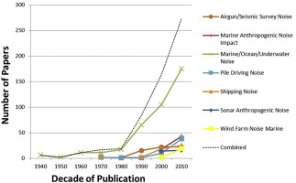
Furthermore, data analytics can assist in identifying the sources of noise pollution.
By analyzing noise data alongside other contextual information, such as traffic patterns, weather conditions, and land use, it becomes possible to attribute noise events to specific sources like road traffic, construction sites, industrial facilities, or even social gatherings.
This level of granularity is essential for crafting targeted interventions and policies.
Temporal analysis is another critical aspect of noise pollution management.
Data analytics can reveal daily, weekly, or seasonal variations in noise levels, helping us understand when noise pollution is most severe.
This information can inform the scheduling of construction activities, the implementation of noise ordinances, and even the planning of green spaces or noise-buffering infrastructure to provide relief during high-noise periods.

Slide 5
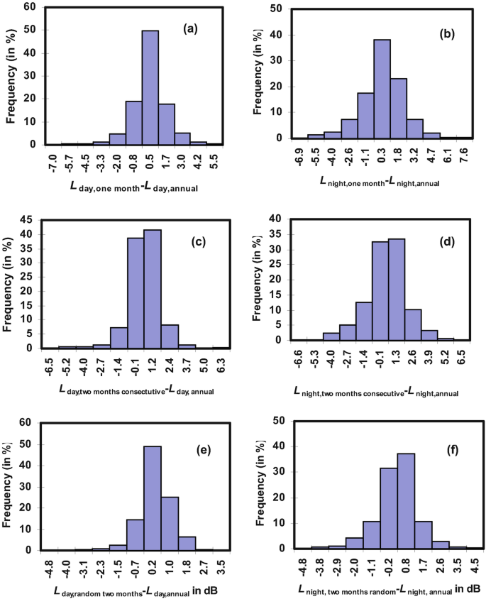
Machine learning algorithms can be employed to predict future noise pollution levels based on historical data and external factors, allowing for proactive measures to be taken.
For example, if a certain neighborhood consistently experiences elevated noise levels during the weekends due to nightlife activities, local authorities can anticipate the issue and allocate resources accordingly.
Moreover, data analytics can support the evaluation of the effectiveness of noise reduction measures and policies.
By continuously monitoring noise levels and comparing them to baseline data, decision-makers can assess whether interventions, such as sound barriers, zoning regulations, or traffic management strategies, are achieving their intended outcomes.

Slide 6
HIGH-NOISE AREAS:
Leveraging data analytics to identify high noise areas is pivotal for addressing the escalating issue of noise pollution in urban landscapes.
With the advent of advanced sensor technologies and data collection methods, we can now harness data analytics to pinpoint specific geographic locations that are disproportionately affected by noise pollution.
Data analytics begins with the collection of comprehensive noise data through strategically placed sound sensors, mobile apps, and even citizen-contributed reports.
These sources provide a rich dataset that can be processed and analyzed to discern noise patterns across different regions.
By aggregating and visualizing this data on geographic maps, we can readily identify areas with consistently high noise levels.

Slide 7
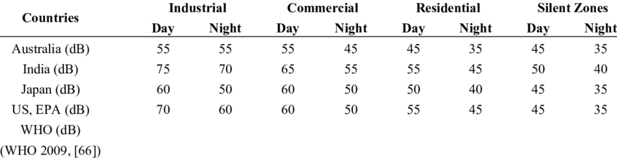
Machine learning models can play a crucial role in predicting and identifying high noise areas.
These models can learn from historical noise data and other contextual information, making it possible to forecast noise levels in real-time or over specific time periods.
Predictive analytics can provide valuable insights into which areas are likely to experience noise spikes, allowing for proactive measures.
Identifying high noise areas is a fundamental step in urban planning and policy-making.
Once these areas are identified, city authorities can implement targeted interventions, such as noise barriers, altered traffic patterns, or zoning regulations, to mitigate noise pollution effectively.
This data-driven approach not only improves the quality of life for residents in high noise areas but also contributes to a more sustainable and peaceful urban environment overall.

Slide 8
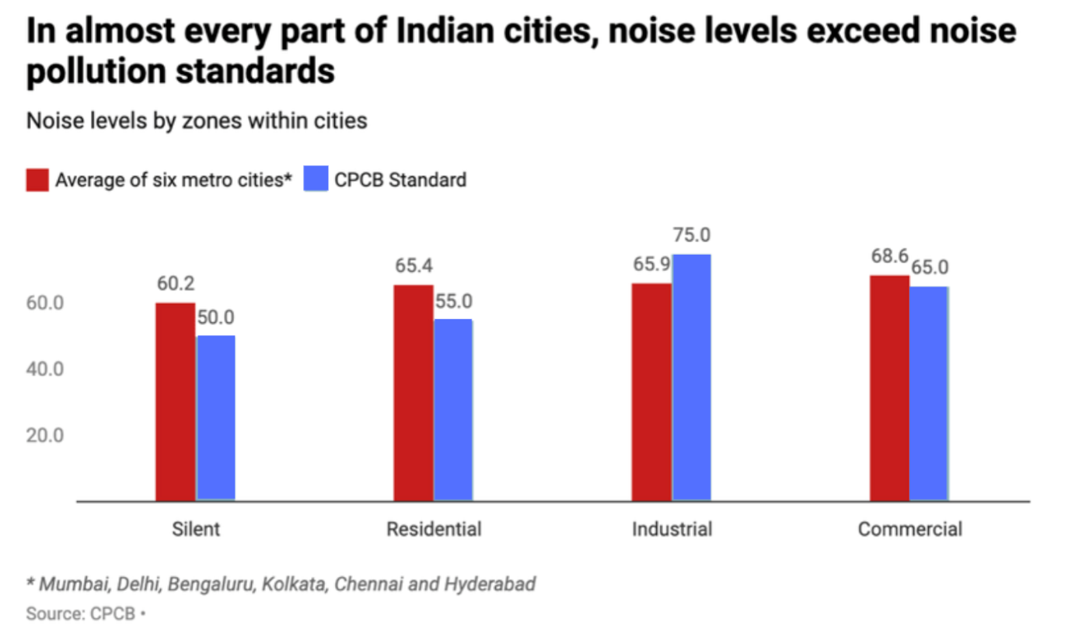
The analytics process involves various techniques, including spatial clustering and statistical analysis.
Spatial clustering algorithms can group together areas exhibiting similar noise profiles, highlighting potential noise hotspots.
Additionally, statistical analysis can help identify correlations between noise levels and factors such as traffic volume, industrial activities, or even social events.

Slide 9
POTENTIAL SOURCES:
Leveraging data analytics to identify potential sources of noise pollution is crucial for understanding the root causes of excessive noise in urban areas.
By harnessing advanced data processing techniques and sensor technologies, we can pinpoint and attribute noise events to specific sources, facilitating targeted mitigation strategies.
Data analytics begins with the collection of detailed noise data from various sensors placed strategically across the urban landscape.
This data is then analyzed using pattern recognition algorithms to differentiate between different types of noise signatures.
By comparing noise profiles with contextual data, such as traffic patterns, weather conditions, and land use, analytics can

Slide 10
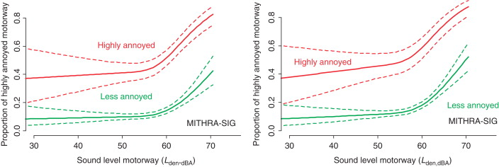
Identifying potential sources of noise pollution is instrumental in developing effective noise mitigation strategies.
Once sources are identified, city planners and policymakers can implement targeted interventions, such as noise barriers, soundproofing measures, or changes in operating hours for noisy activities.
Data analytics not only helps us address noise pollution but also fosters a quieter, more livable urban environment by targeting the sources of excessive noise.

Slide 11
THESE ARE TOPICS OF PHASE 2: INNOVATION
BY TEAM MATES:
1. Ezhilarasi. A
2. Hruthik kumar J.S
3. Iswariya. L
4. Kalpana. G
5. Kanishka. K

